Slide 1

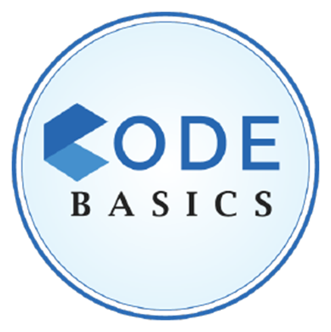
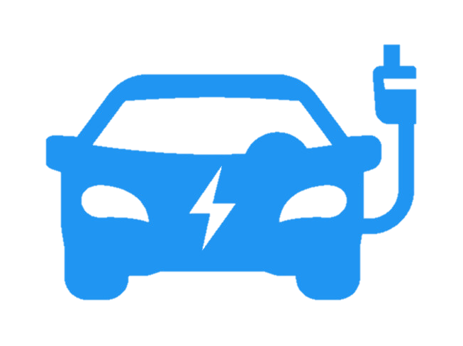
RESUME PROJECT CHALLENGE #12:
ELECTRIC VEHICLES ANALYSIS

Slide 2
AGENDA
BACKGROUND
PROBLEM STATEMENT
PRIMARY QUESTIONS
SECONDARY QUESTIONS
DASHBOARD SHOWCASE
RECOMMENDATIONS

Slide 3
BACKGROUND
India’s journey into electric vehicles began with the establishment of the Reva Electric Car Company in 1994, based in Bangalore.
Tata Motors has emerged as a key player and is currently the market leader in the Indian EV market, particularly in the four-wheeler segment.
Mahindra & Mahindra, also made early strides with the e2o, an updated version of the Reva.
Ola Electric has quickly become a dominant player in the two-wheeler segment with the launch of its electric scooters, Ola S1 and S1 Pro, in 2021, focusing on affordable electric mobility.
Karnataka became one of the first states to actively promote electric vehicles by introducing the Karnataka Electric Vehicle and Energy Storage Policy in 2017.
Delhi has also been a pioneer in promoting EV adoption. The Delhi Electric Vehicle Policy, launched in 2020, aims to set up extensive charging infrastructure and targets a significant increase in EV adoption by 2024.

Slide 4

PROBLEM STATEMENT
AtliQ Motors, a leading automotive giant from the USA, has specialized in electric vehicles (EV) and successfully increased its market share to 25% in the electric and hybrid vehicle segment across North America over the last five years. As part of their strategic expansion plans, AtliQ Motors aims to launch their bestselling models in India, a market where they currently hold less than a 2% share. Bruce Haryali, the Chief of AtliQ Motors India, has commissioned a comprehensive market study of the existing EV/Hybrid market in India to guide the company’s strategy.

Slide 5
PRIMARY QUESTIONS

Slide 6
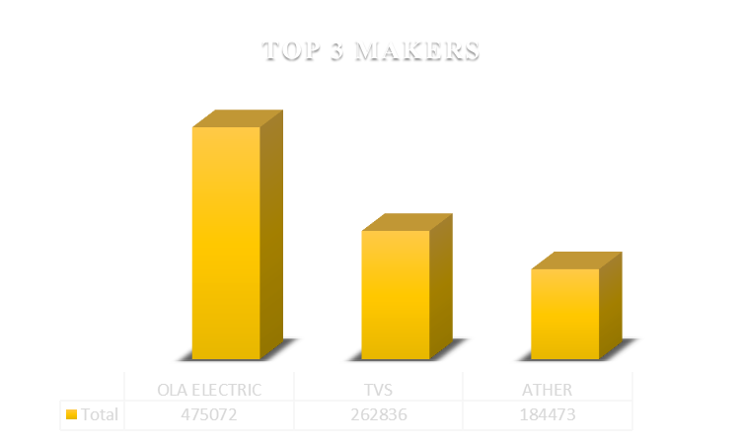
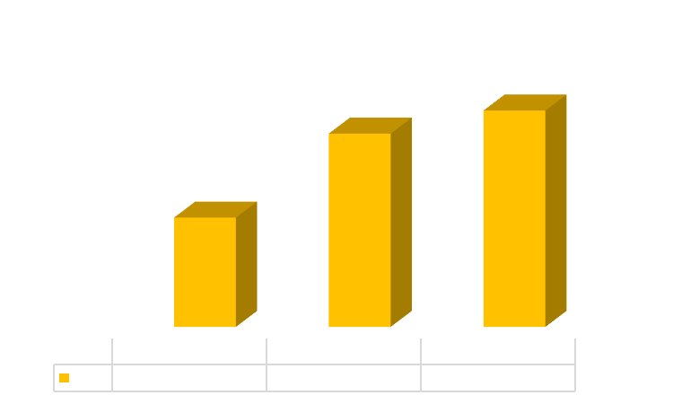
List the Top 3 and Bottom 3 makers for the fiscal year 2023 and 2024 in terms
of the number of 2-Wheelers sold?

Slide 7
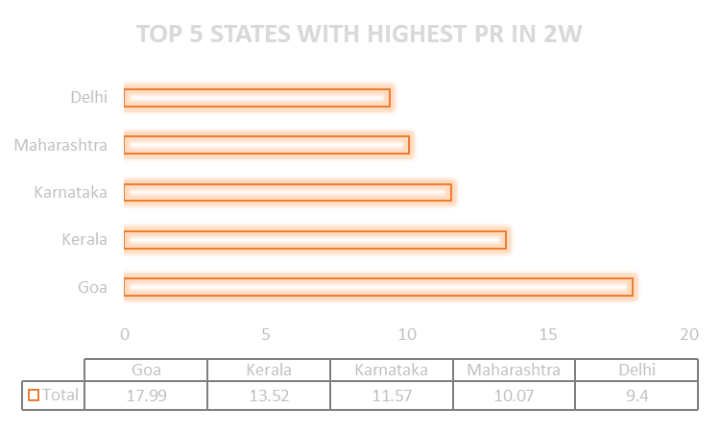
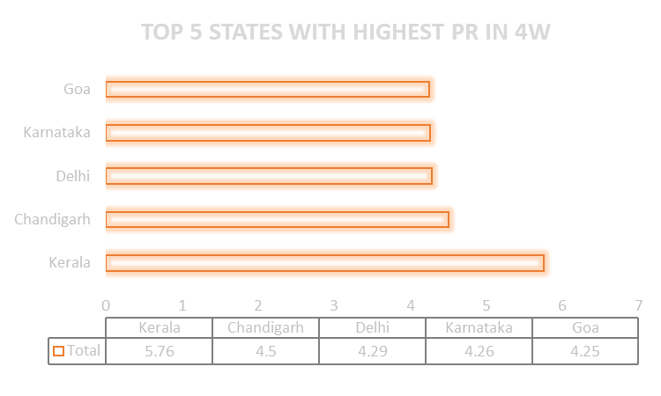
2. Identify the Top 5 States with the highest Penetration Rate in 2-Wheelers and
4-Wheelers electric vehicles Sales in FY 2024?
These insights reveal the regional differences in EV adoption, with Goa and Kerala consistently showing strong penetration rates across both vehicle segments.

Slide 8

3. List the States with negative penetration rate (decline) in EV-sales from 2022
to 2024 ?

Slide 9
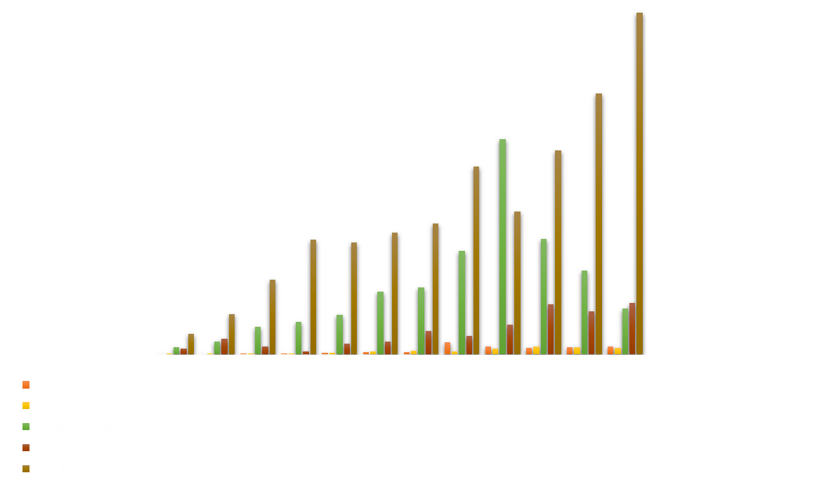
4. What are the Quarterly trends based on the sales volume for the Top 5
EV-makers (4-Wheelers) from 2022 to 2024?

Slide 10


5. How do the EV-sales and penetration rates in Delhi compare to Karnataka
for 2024?

Slide 11
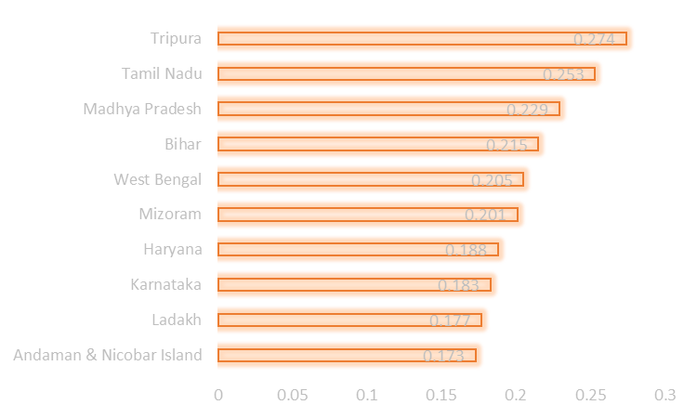
6. List down the Top 10 States that had the highest compounded annual growth
rate (CAGR) from 2022 to 2024 in total vehicles solid?
STATE | CAGR
A & N Island | 0.173
Ladakh | 0.177
Karnataka | 0.183
Haryana | 0.188
Mizoram | 0.201
West Bengal | 0.205
Bihar | 0.215
Madhya Pradesh | 0.229
Tamil Nadu | 0.253
Tripura | 0.274

Slide 12
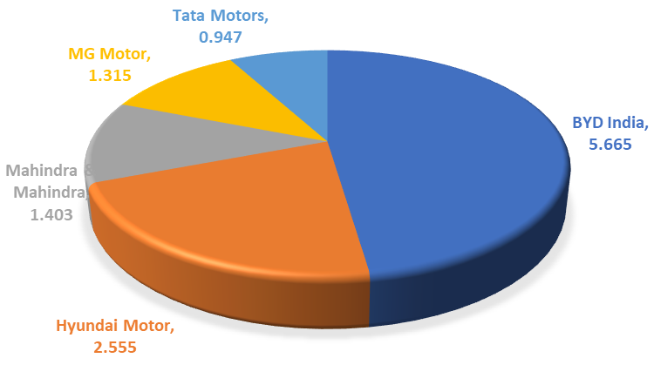
7. List down the compounded annual growth rate (CAGR) in 4-Wheelers units
for the Top 5 makers from 2022 to 2024?
MAKERS | SALES (22-24) | CAGR
BYD India | 2419 | 5.665
Hyundai Motor | 2076 | 2.555
Mahindra & Mahindra | 41193 | 1.403
MG Motor | 13753 | 1.315
Tata Motors | 88935 | 0.947

Slide 13


8. What are the peak and low season months for EV-sales based on the data
from 2022 to 2024?

Slide 14
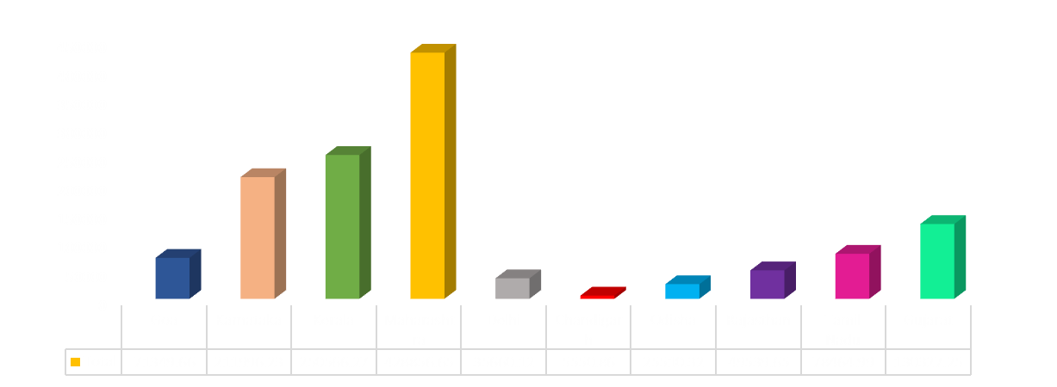
9. What is the projected number of EV-sales (including 2W and 4W) for the Top 10 States by penetration rate in 2030, based on the compounded annual growth rate (CAGR) for previous years?
STATE | AVG PR
Goa | 10.42
Karnataka | 7.96
Kerala | 7.96
Maharashtra | 6.66
Delhi | 6.58
Chandigarh | 4.71
Odisha | 4.58
Rajasthan | 4.56
Tamil Nadu | 4.42
Gujarat | 4.27
Projected Number Of EV-Sales in 2030

Slide 15


10. Estimate the revenue growth rate of 4W and 2W EVs in India for 2022 Vs 2024 and 2023 Vs 2024, assuming an average unit price.
Vehicle Category | Average Price
2-Wheelers | 85000
4-Wheelers | 1500000
Total Revenue Year-Wise
Veh. Category | FY2022 | FY2023 | FY2024
2-Wheelers | 21468705000 | 61871755000 | 79278820000
4-Wheelers | 27865500000 | 71197500000 | 1.30352E+11

Slide 16
SECONDARY QUESTIONS

Slide 17
1. What are the primary reasons for customers choosing 4-Wheelers EVs in 2023
and 2024 ?
ENVIRONMENT CONCERNS
COST SAVINGS
GOVERNMENT INCENTIVES
RISING FUEL COSTS
URBANIZATION
GLOBAL SUSTAINABLE MOBILITY
Lower fuel and maintenance costs.
Preference for sustainable and eco-friendly transportation options.
Attractive subsidies, tax rebates, and reduced registration fees offered by the government.
Availability of incentives for installing home charging stations and reduced electricity tariffs for EV charging.

Slide 18
2. How do government incentives and subsidies impact the adoption rates of 2-Wheelers and 4-Wheelers ? Which State in India provided most subsidies?
WHAT IS SUBSIDY?
A subsidy is a direct financial aid provided by the government to reduce the cost of goods or services. In the context of EVs, subsidies are typically provided to lower the purchase price of electric vehicles, making them more affordable for consumers.
WHAT IS INCENTIVE?
An incentive is a benefit or reward given to encourage people to take a certain action. It doesn’t always involve money but can include things like tax breaks, fee waivers, and support for infrastructure development, which make EV ownership more appealing and cost-effective in the long run.

Slide 19
SUBSIDIES | INCENTIVES
Under the FAME-II scheme in India, the government provides a direct subsidy to buyers of electric vehicles. In some states, an electric two-wheeler buyer might receive a subsidy of up to ₹20,000, which directly reduces the price of the vehicle at the time of purchase. Some governments offer subsidies specifically for the cost of EV batteries. For example, if a government offers a subsidy of ₹10,000 per kilowatt-hour (kWh) of battery capacity, this would reduce the overall price of the EV, particularly for models with larger batteries. | Many states in India, like Delhi and Maharashtra, offer exemptions from road tax and registration fees for electric vehicles. By eliminating these costs, the government makes owning an EV more economical. The Indian government offers a tax deduction of up to ₹1.5 lakh for the interest paid on loans taken for purchasing an electric vehicle. This incentive reduces the overall financial burden on the buyer by making it more financially attractive to purchase an EV.

Slide 20
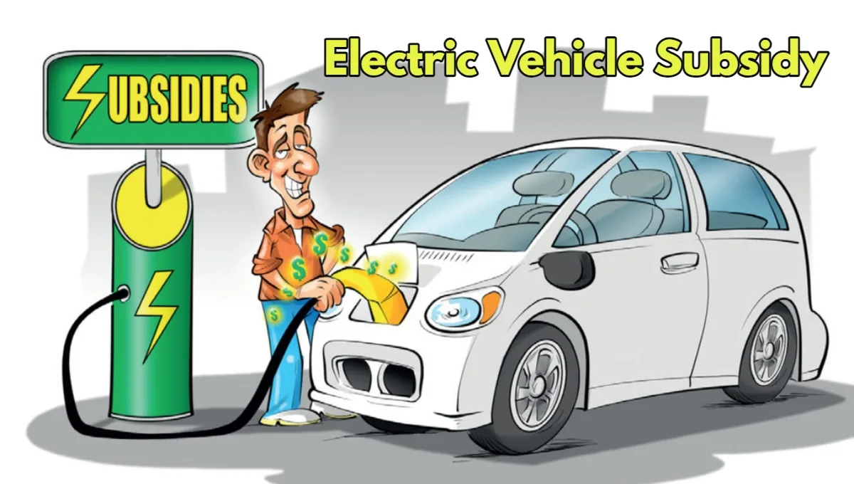
TOP 3 EV-friendly States that Offer Best Subsidies
1. Gujarat
Two-wheeler: Maximum up to Rs. 20,000
Three-wheeler: Benefits up to Rs. 50,000
Four-wheeler: Maximum up to Rs. 1.5 lakh
2. Maharashtra
Two-wheeler: Maximum up to Rs. 25,000
Three-wheeler: Benefits up to Rs. 30,000
Four-wheeler: Maximum up to Rs. 2.5 lakh
3. Meghalaya
Two-wheeler: Maximum up to Rs. 20,000
Four-wheeler: Maximum up to Rs. 60,000

Slide 21
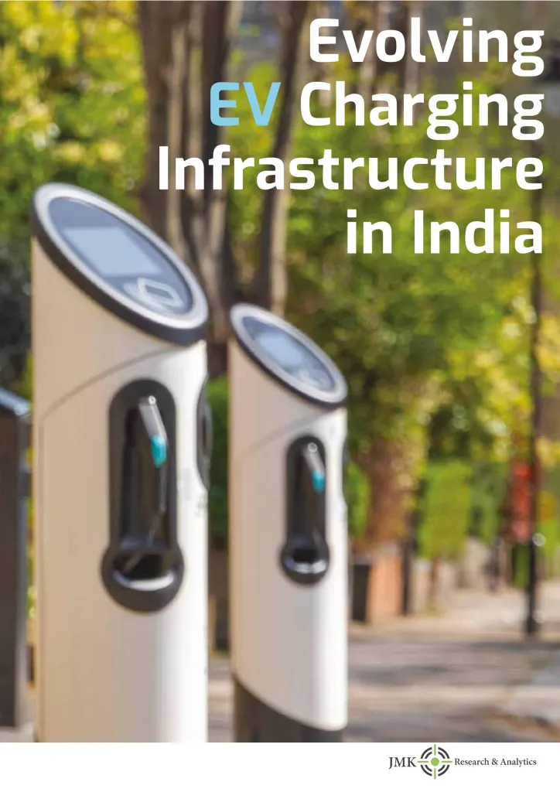
3. How does the availability of charging stations infrastructure correlate with the
EV-sales and penetration rates in the Top 5 States?
A study conducted by the International Energy Agency (IEA) revealed that in markets where a comprehensive and well-distributed charging network exists, the sales of electric vehicles are markedly higher compared to regions with limited infrastructure.
States with well-developed charging infrastructure (like Delhi, Maharashtra, Karnataka) tend to see higher EV sales and penetration rates. Consumers are more likely to purchase EVs when they know they have reliable access to charging, both at home and in public.

Slide 22

4. Who should be the Brand Ambassador if AtliQ Motors launches their EV/Hybrid
vehicles in India and why ?
Virat Kohli is a highly popular figure among the youth.
As a sports icon known for his commitment to fitness and healthy living, Virat aligns well with the eco-friendly and sustainable image of EVs.
With a massive following across India and strong influence on social media, Virat can drive widespread awareness and interest in AtliQ Motors’ vehicles.

Slide 23
5. Which State of India is ideal to start the manufacturing unit (Based on subsidies provided, ease of doing business, stability in governance, etc.) ?
Tamil Nadu has a well-established automotive industry, hosting major manufacturers like Hyundai, Ford, BMW, and Renault-Nissan.
The state offers substantial subsidies and incentives under its EV policy, including capital subsidies, stamp duty exemptions, and electricity tariff concessions for EV manufacturing.
Tamil Nadu consistently ranks high in ease of doing business, with streamlined processes for obtaining permits and clearances. The state also offers single-window clearance for industrial projects.
With a large pool of skilled and semi-skilled labor, Tamil Nadu is known for its technical expertise in the manufacturing sector.

Slide 24
DASHBOARD

Slide 25
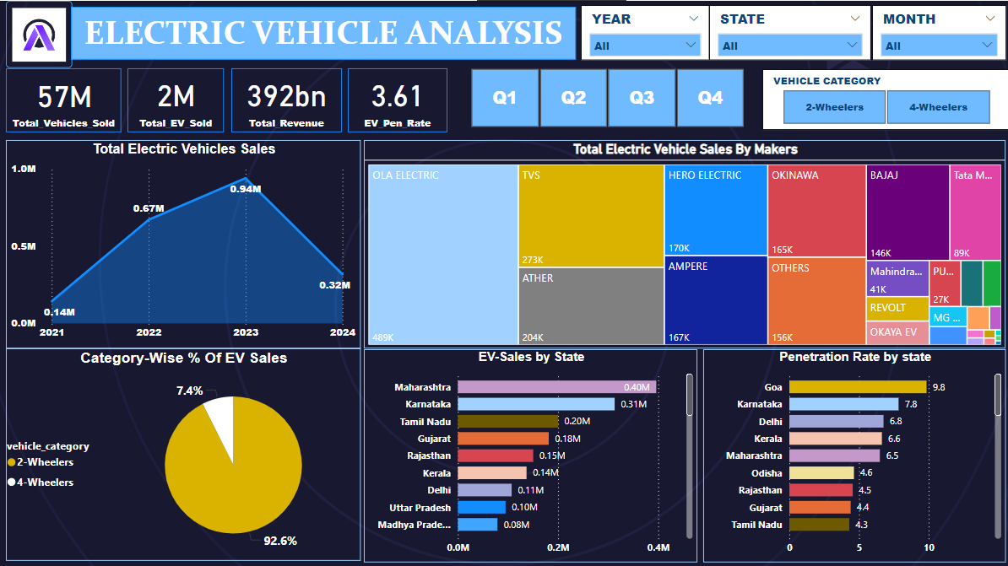

Slide 26
RECOMMENDATIONS
State-Specific Strategies:
States like Tamil Nadu, Gujarat, and Karnataka are especially good for setting up factories because they make it easier for companies to start and grow. By focusing on these states, AtliQ Motors can get their operations up and running faster and more smoothly.
2. Consumer Preferences and Adoption Drivers
People in India are buying electric vehicles mainly because they save money, EV are better for the environment, and have support from the government like subsidies. For 4-wheelers, these reasons are even more important. To attract more buyers, AtliQ Motors should emphasize how their vehicles can save money and help the environment.

Slide 27
3. Tailored Incentives for Two-Wheelers and Four-Wheelers
The Indian government offers several financial benefits to make electric vehicles cheaper and more attractive, like subsidies and tax rebates. AtliQ Motors should take full advantage of these benefits to lower the cost of their vehicles for customers. This not only helps customers save money but also aligns the company with India's goals of reducing pollution and promoting green energy.

Slide 28
THANK YOU
By: ANMOL KAPOOR

